Slide 1
IMAGE ANALYSIS VISUAL CONVENTIONS

Slide 2
MIND MAP FOR VISUAL ANALYSIS
STYLE/
VISUAL LANGUAGE CONVENTIONS
POINT OF VIEW (POV) OR
PERSPECTIVE
(ie. TEEN, DOG, PARENT)
THEME(S)
OF TEXT
VISUAL TEXT
REPRESENTATION
OF
PEOPLE
REPRESENTATION OF
EVENTS
REPRESENTATION OF
PLACES

Slide 3

CONTENT: REPRESENTATION OF EVENTS
EVENTS PLACES PEOPLE
1. SELECTION = PRIVILEGED
2. OMISSION = MARGINALISED OR SILENCED
3. EMPHASIS = REPEATED OR HIGHLIGHTED

Slide 4
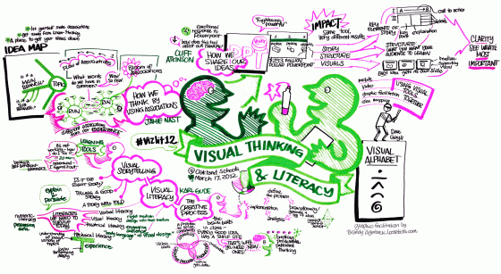
SWAT CODE = VISUAL LANGUAGE CONVENTIONS

Slide 5

SYMBOLIC CODE
COLOUR
CLOTHING
LIGHTING
SETTING
OBJECTS
BODY LANGUAGE:
(PROXIMITY, GESTURE, FACIAL EXPRESSION, OBJECTS, GAZE, ORIENTATION)

Slide 6
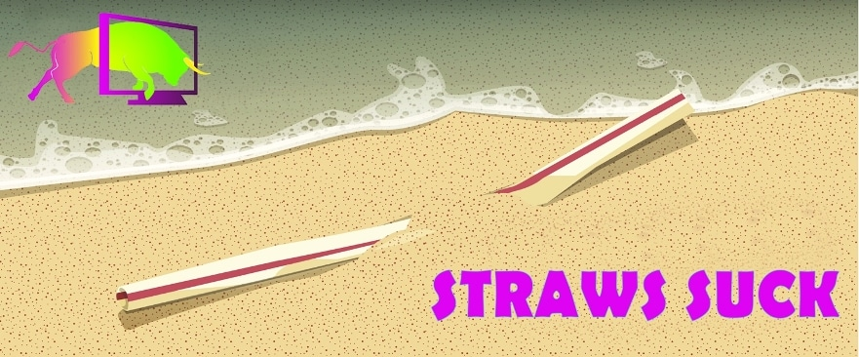
WRITTEN CODE
TEXT TITLES
SUBTITLES
CREDITS
ANY OTHER WRITTEN TEXT

Slide 7

AUDIO CODE
DIALOGUE
MUSIC
SPECIAL EFFECTS
(AUDIO SPECIAL EFFECTS)

Slide 8
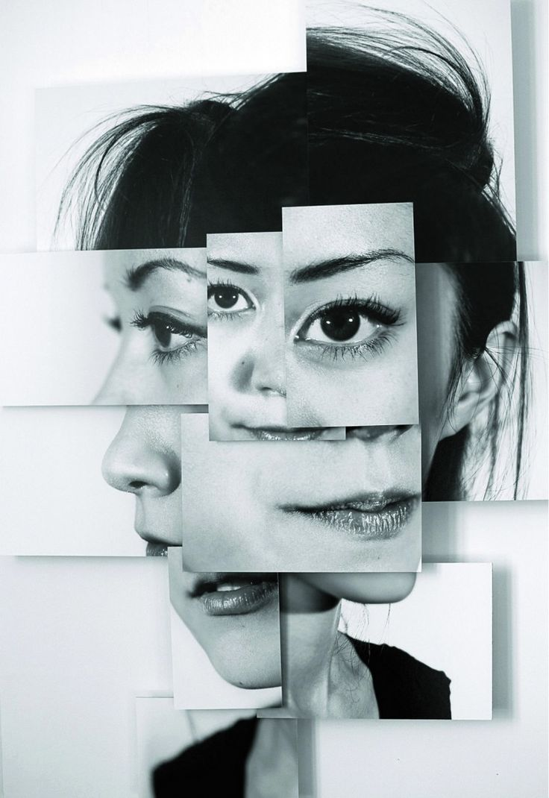
TECHNICAL CODE
SHOT SELECTION CAMERA ANGLES
CAMERA DISTANCE CAMERA MOVEMENT
MONTAGE JUXTAPOSITION
LEADING LINES OR VECTORS LIGHTING
RULE OF THIRDS LENS SELECTION
DEPTH OF FIELD FRAMING
COMPOSITION

Slide 9
TURN THE PAGE AND WRITE YOU ANSWERS
WHAT DOES THE ACRONYM SWAT STAND FOR?
UNDER EACH TITLE WRITE DOT POINTS YOU REMEMBER

Slide 10

TECHNICAL CONSTRUCTION: VIEWER PERSPECTIVE….
VIEWING ANGLE
Birds eye view
or drone shot
High
Eye level
Low angle
Worms eye view (extremely threatening)
CONSIDER: HIGH ANGLES TEND TO MAKE A SUBJECT LESS POWERFUL. LOW ANGLES TEND TO MAKE A SUBJECT MORE THREATENING OR IMPORTANT.

Slide 11
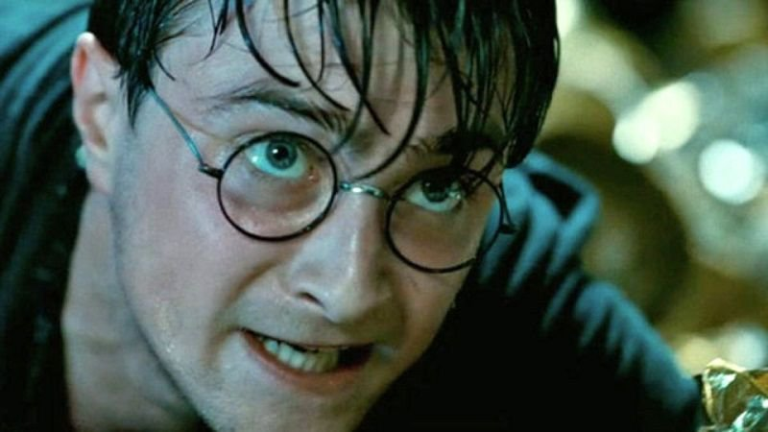
TECHNICAL CONSTRUCTION: VIEWER PERSPECTIVE….
VIEWING DISTANCE
Close up
Medium shot
Long shot
CONSIDER: CLOSE UPS TEND TO CREATE INTIMACY BETWEEN VIEWER AND SUBJECT. MEDIUM GIVES CONTEXT. LONG SHOTS CREATE EMOTIONAL DISTANCE AND DESIGNATE LOCATION.

Slide 12
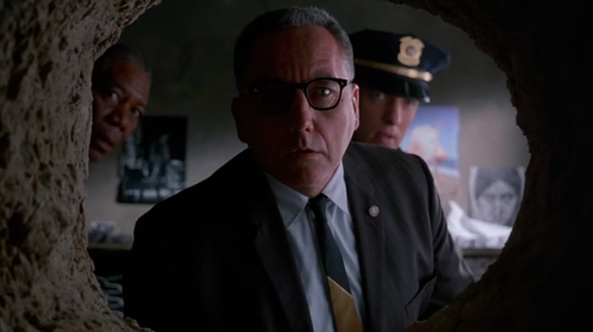
TECHNICAL CONSTRUCTION: VIEWER PERSPECTIVE….
FRAMING
AFFECTS WHAT THE VIEWER
SEES AND DOES NOT SEE.
THE VIEWER CAN BE AWARE
OF WHAT THE SUBJECT IS NOT
AWARE OF OR VICE VERSA
(DRAMATIC IRONY).

Slide 13
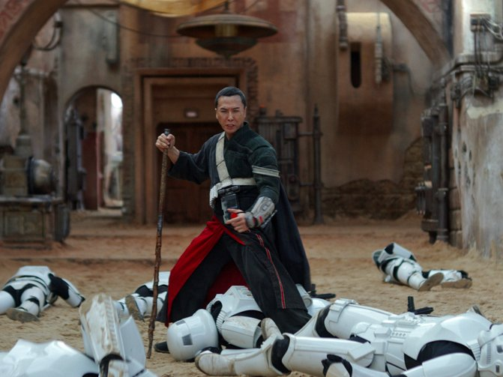
TECHNICAL CONSTRUCTION: VIEWER PERSPECTIVE….
FOCUS
WHAT IS IN FOCUS IS
IMPORTANT.

Slide 14

TECHNICAL CONSTRUCTION: COMPOSITION….
VIEW WITH PURPOSE
HOW ARE THE ELEMENTS OF AN IMAGE ARRANGED?
WHY ARE THE ELEMENTS OF AN IMAGE ARRANGED THAT WAY?
1. FOREGROUNDING & BACKGROUNDING
2. CENTRING AND MARGINALISING
CONSIDER: OBJECTS THAT ARE FOREGROUNDED AND
CENTRED APPEAR MORE IMPORTANT OR POWERFUL
THAN THOSE WHICH ARE BACKGROUNDED OR AT THE
EDGE OF THE FRAME (MARGINALISED).

Slide 15
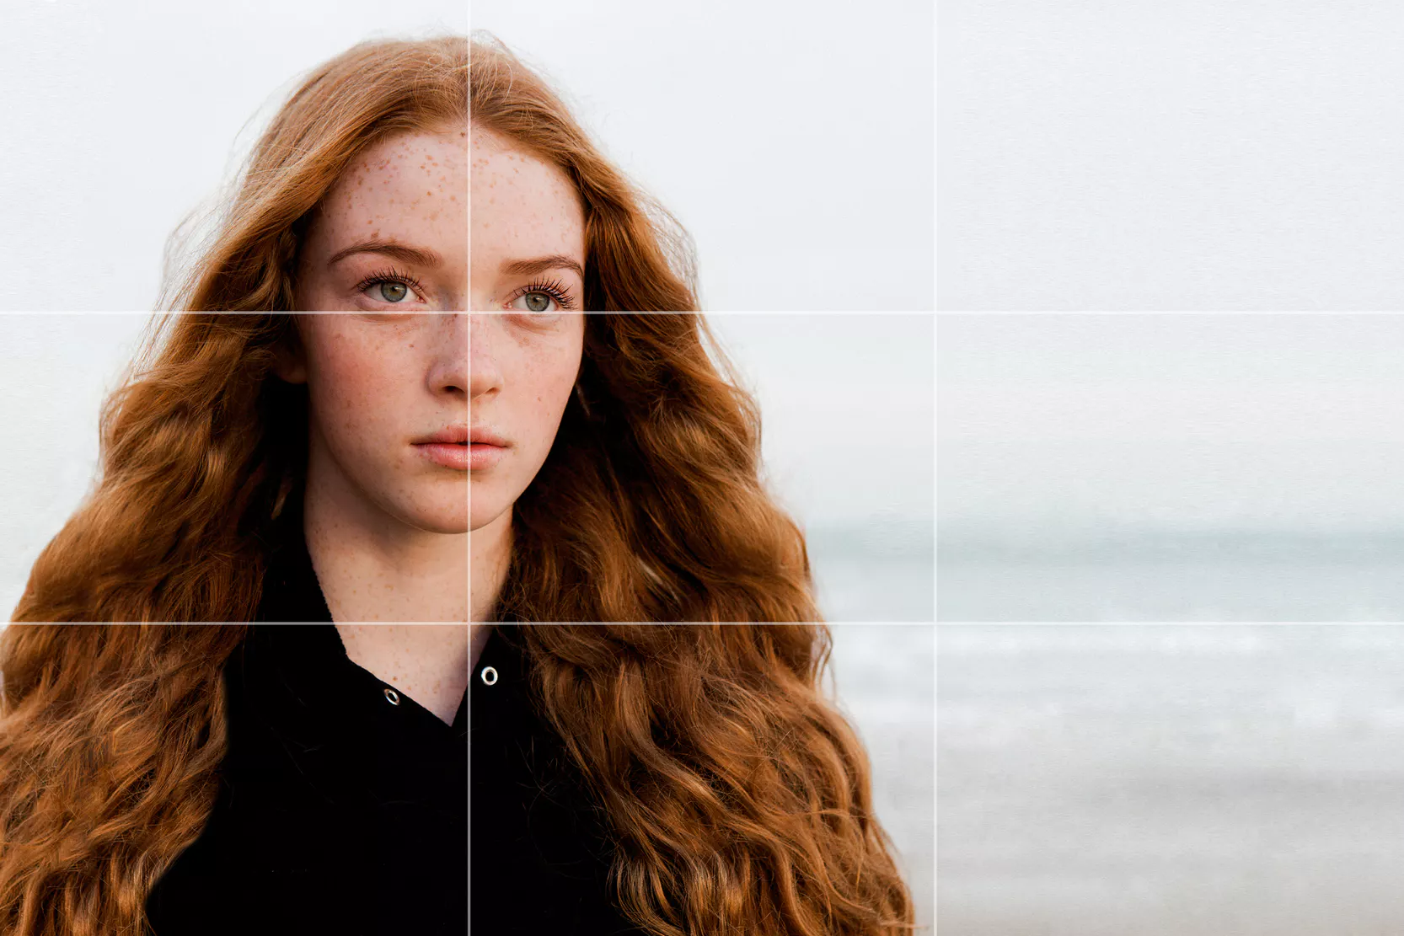
TECHNICAL CONSTRUCTION: COMPOSITION
RULE OF THIRDS
1. EMPHASIS AND IMPORTANCE
IS GIVEN TO A PARTICULAR
ELEMENT CONVEYING IMPORTANCE.
2. AN IMAGE CONSISTS OF
NINE PARTS.
3. MAIN POINTS OF INTEREST IN AN
IMAGE SHOULD BE PLACED ALONG
ONE OF THE BANDS OR ON ONE
OF THE INTERSECTION POINTS.

Slide 16

TECHNICAL CONSTRUCTION: COMPOSITION
JUXTAPOSITION
THE PLACEMENT NEXT TO EACH OTHER
OF TWO UNEXPECTED THINGS TO CREATE
MEANING THAT EACH ALONE WOULD
NOT SUGGEST.

Slide 17


TECHNICAL CODE FOR IMAGE ANALYSIS
SHOT SELECTION CAMERA ANGLES
CAMERA DISTANCE CAMERA MOVEMENT
MONTAGE JUXTAPOSITION
LEADING LINES OR VECTORS LIGHTING
RULES OF THIRDS LENS SELECTION
DEPTH OF FIELD FRAMING
COMPOSITION

